Slide 1
Big mountain: ticket pricing and facilities
Sahar Manavi – January 2021

Slide 2
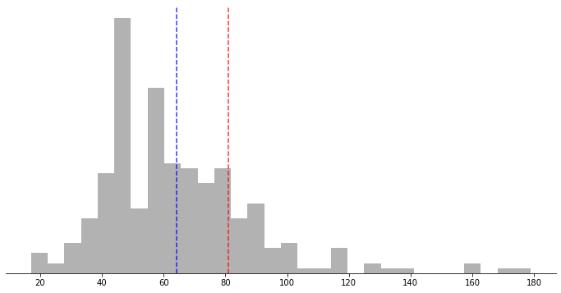
Currently We set our ticket prices to be slightly above the market average.
Ticket price distributions for resorts in market share
Big Mountain
Average
Adult weekend ticket price ($)

Slide 3
However, we are much more than “slightly” above Average
Where Big Mountain ranks:
Skiable terrain area: 98th percentile
Snow making area: 97th percentile
Longest run: 96th percentile
Number of lifts: 94th percentile
Number of fast quad lifts: 93rd percentile
Vertical drop: 90th percentile

Slide 4
How can we better leverage our top tier resort?
3 options based on what we would like to do with our facilities:
Decrease
Close one run without a reduction in ticket price.
Close up to 5 runs with approx. reduction in ticket price of 67¢.
Increase
Add one run and lift, increasing our vertical drop, for ticket price increase of $1.99.
Consider instead making new lift a fast quad for potential ticket price increase of $23.87.
No change
We are under-charging for our current facilities.
Even changing nothing, we can increase ticket price by up to $14.87.

Slide 5
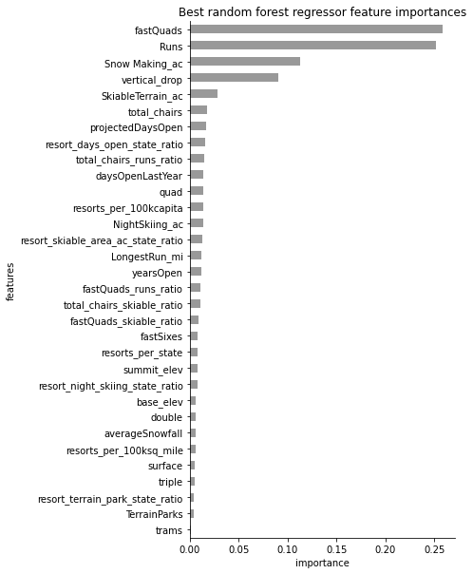
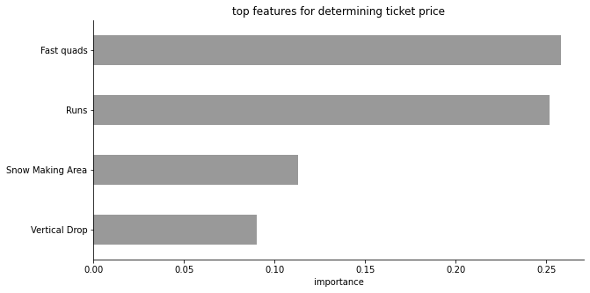
There are four key features
Our model found 4 features across all resorts that had the largest impact on ticket price. These are the features that customers are most willing to pay more for.

Slide 6
Scenario 1: Decrease facilities
Proposal:
Close up to 10 of the least used runs
Outcome:
Closing 1 run requires no change to ticket price
Closing 2 runs requires a ticket reduction of 41¢
Closing 3, 4, or 5 runs requires a ticket reduction of 67¢
Closing 6+ runs reduces ticket price by $1.26 or more
Why does this scenario work?
This is an easy solution to save on operation costs over the course of a season. While number of runs is a key feature when determining ticket price, our model suggests we have some leeway.

Slide 7
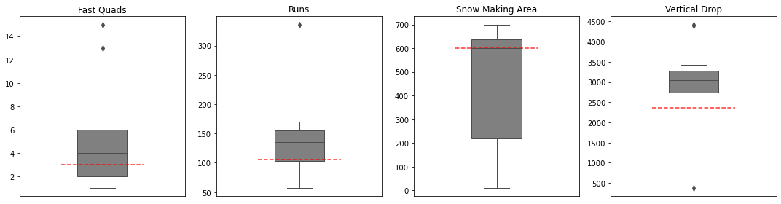
Scenario 2: Increase facilities
Proposal:
Add a run
Increase vertical drop by 150 ft
Add a chair lift for new run
Outcome:
Increased ticket price: $1.99
Projected additional revenue: $3,474,638
Why does this scenario work?
Compared to other top resorts, Big Mountain is below average on two key features that this proposal addresses.

Slide 8
Scenario 2B: Increase facilities
Proposal:
Add a run
Increase vertical drop by 150 ft
Add a fast quad lift
Outcome:
Increased ticket price: $23.87
Projected additional revenue: $41,771,993
Why does this scenario work?
Recall fast quad lifts are the number one key feature customers are willing to pay more for. Adding one more fast quad puts Big Mountain at the median compared to other top resorts.

Slide 9
Conclusions
We can increase our ticket price for this coming season without making any changes whatsoever.
We have options to either increase or decrease the number of features and facilities we have available, to either reduce operation costs or increase income.
For any options requiring changes to facilities, further analysis will need to be done that takes operation cost changes into account to get a more accurate picture of revenue changes.

